Slide 1
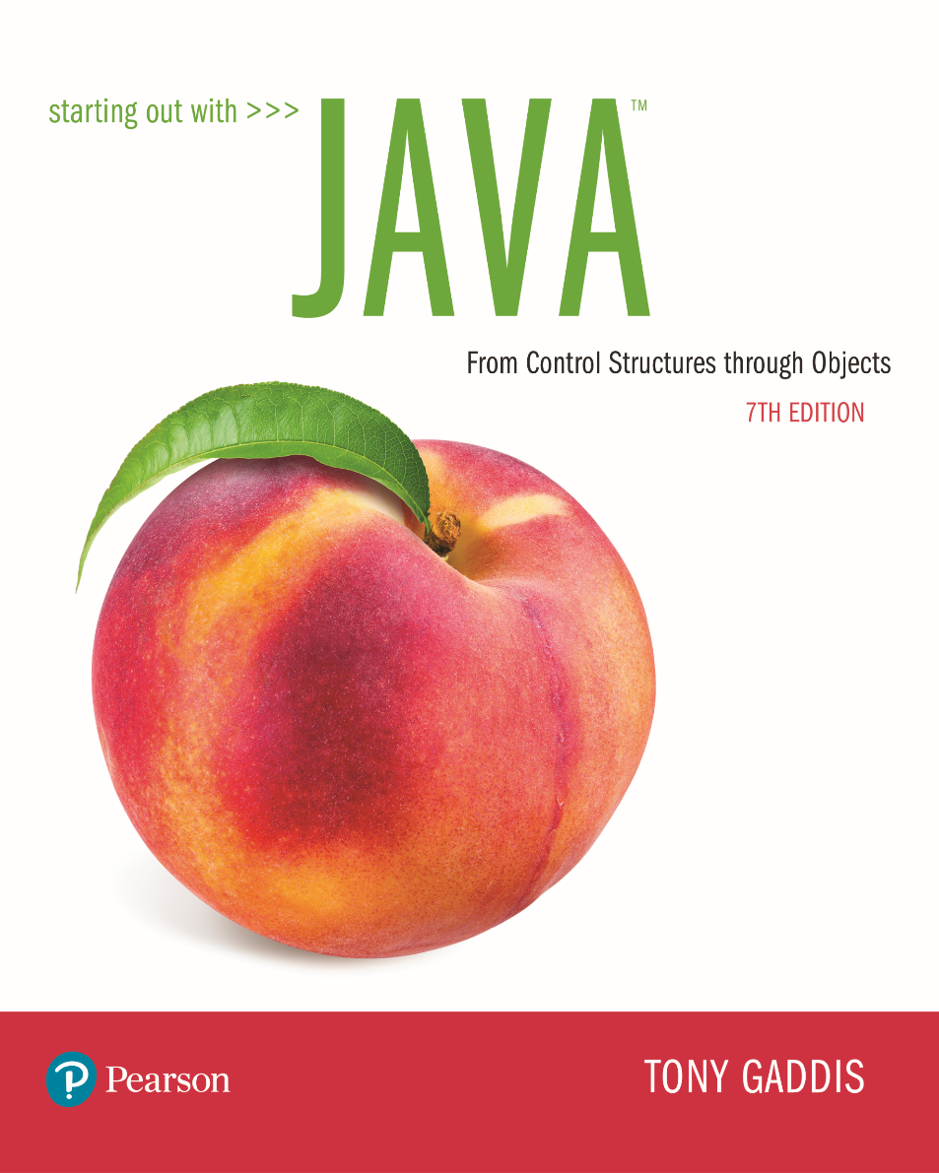

Slide 2
Examples’ Source Code
Source Code for examples presented in these slides can be found on:
Blackboard->Course Content->Source Code Of The Book Examples

Slide 3
Module Topics
Module 6 discusses the following main topics:
5.1 Introduction to Methods
5.2 Passing Arguments to a Method
5.3 More About Local Variables
5.4 Returning a Value from a Method
5.5 Problem Solving with Methods

Slide 4
Why Write Methods?
Methods are commonly used to break a problem down into small manageable pieces. This is called divide and conquer.
Methods simplify programs. If a specific task is performed in several places in the program, a method can be written once to perform that task, and then be executed anytime it is needed. This is known as code reuse.

Slide 5
void Methods and Value-Returning Methods
A void method is one that simply performs a task and then terminates.
System.out.println("Hi!");
A value-returning method not only performs a task, but also sends a value back to the code that called it.
int number = Integer.parseInt("700");

Slide 6
Defining a void Method
To create a method, you must write a definition, which consists of a header and a body.
The method header, which appears at the beginning of a method definition, lists several important things about the method, including the method’s name.
The method body is a collection of statements that are performed when the method is executed.

Slide 7
Two Parts of Method Declaration
Header
public static void displayMesssage()
{
System.out.println("Hello");
}
Body
Method modifiers
public—method is publicly available to code outside the class
static—method belongs to a class, not a specific object.

Slide 8
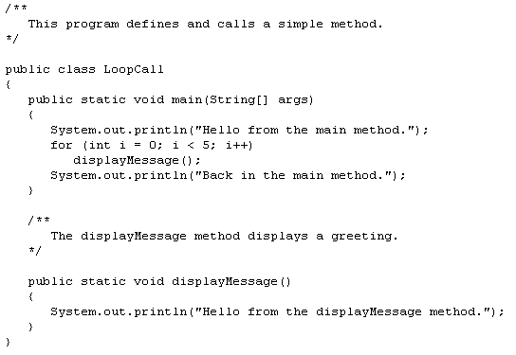
Allows calls to the
methods without creating
an object of LoopCall

Slide 9
Parts of a Method Header
Method Modifiers
Return Type
Method Name
Parentheses
public static void displayMessage ()
{
System.out.println("Hello");
}

Slide 10
Parts of a Method Header
Method modifiers
public—method is publicly available to code outside the class
static—method belongs to a class, not a specific object.
Return type—void or the data type from a value-returning method
Method name—name that is descriptive of what the method does
Parentheses—contain nothing or a list of one or more variable declarations if the method is capable of receiving arguments.

Slide 11
Calling a Method
A method executes when it is called.
The main method is automatically called when a program starts, but other methods are executed by method call statements.
displayMessage();
Notice that the method modifiers and the void return type are not written in the method call statement. Those are only written in the method header.
Examples: SimpleMethod.java, LoopCall.java, CreditCard.java, DeepAndDeeper.java

Slide 12
Documenting Methods
A method should always be documented by writing comments that appear just before the method’s definition.
The comments should provide a brief explanation of the method’s purpose.
The documentation comments begin with /** and end with */.

Slide 13
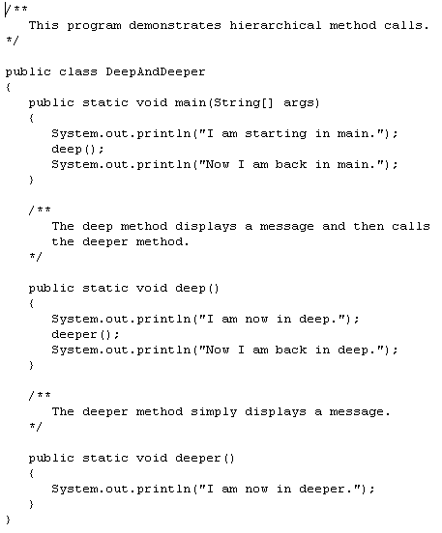
What is the
output?
I am starting in main.
I am now in deep.
I am now in deeper.
Now I am back in deep.
Now I am back in main.

Slide 14
Passing Arguments to a Method
Values that are sent into a method are called arguments.
System.out.println("Hello");
number = Integer.parseInt(str);
The data type of an argument in a method call must correspond to the variable declaration in the parentheses of the method declaration. The parameter is the variable that holds the value being passed into a method.
By using parameter variables in your method declarations, you can design your own methods that accept data this way. See example: PassArg.java

Slide 15
Passing 5 to the displayValue Method
in main:
{
. . .
displayValue(5);
. . .
}
public static void displayValue(int num)
{
System.out.println("The value is " + num);
}
The argument 5 is copied into the parameter variable num.
The method will display The value is 5

Slide 16
Argument and Parameter Data Type Compatibility
Error! Can’t convert double to int
When you pass an argument to a method, be sure that the argument’s data type is compatible with the parameter variable’s data type.
Java will automatically perform widening conversions, but narrowing conversions will cause a compiler error.
double d = 1.0;
displayValue(d);

Slide 17
Passing Multiple Arguments
In main:
{
. . .
showSum(5, 10);
. . .
}
public static void showSum(double num1, double num2)
{
double sum; //to hold the sum
sum = num1 + num2;
System.out.println("The sum is " + sum);
}
The argument 5 is copied into the num1 parameter.
The argument 10 is copied into the num2 parameter.
NOTE: Order matters!

Slide 18
Arguments are Passed by Value
In Java, all arguments of the primitive data types are passed by value, which means that only a copy of an argument’s value is passed into a parameter variable.
A method’s parameter variables are separate and distinct from the arguments that are listed inside the parentheses of a method call.
If a parameter variable is changed inside a method, it has no affect on the original argument.
See example: PassByValue.java

Slide 19
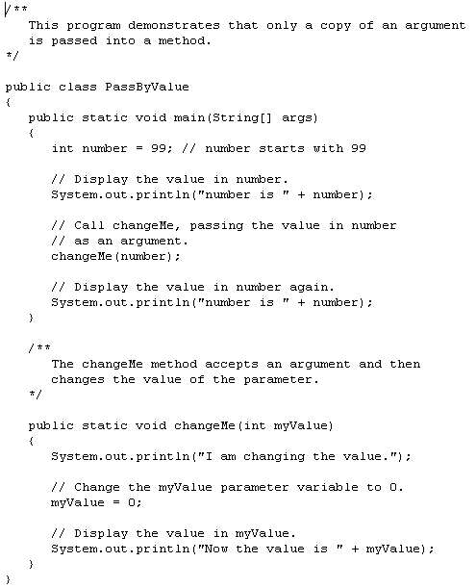
What is the
output?
number is 99
I am changing the value.
Now the value is 0
number is 99

Slide 20
Passing Object References to a Method
Recall that a class type variable does not hold the actual data item that is associated with it, but holds the memory address of the object. A variable associated with an object is called a reference variable.
When an object such as a String is passed as an argument, it is actually a reference to the object that is passed.

Slide 21
Passing a Object Reference as an Argument
In main:
{
. . .
showLength(name);
. . .
}
public static void showLength(String str)
{
System.out.println(str + " is " + str.length() + " characters long.");
str = "Joe" // see next slide
}
Both variables reference the same object
The address of the object is copied into the str parameter.
“Warren”
reference/address
reference/address

Slide 22
Strings are Immutable Objects
In main:
{
. . .
showLength(name);
. . .
}
public static void showLength(String str)
{
System.out.println(str + " is " + str.length() + " characters long.");
str = "Joe“ // a new string is created
}
“Joe”
“Warren”
reference/
address
reference/
address
str = "Joe“ // a new string is created

Slide 23
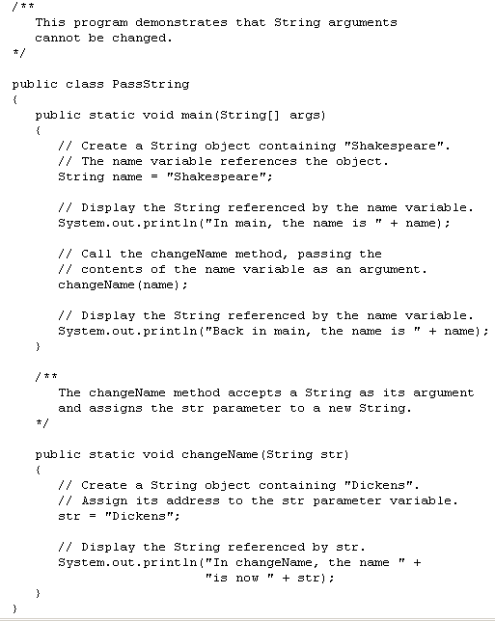
What is the
output?
In main, the name is Shakespeare
In changeName, the name is now Dickens
Back in main, the name is Shakespeare

Slide 24
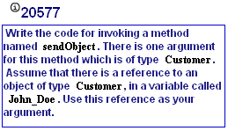
MyProgrammingLab3 5.2

Slide 25
@param Tag in Documentation Comments
You can provide a description of each parameter in your documentation comments by using the @param tag.
General format
@param parameterName Description
See example: TwoArgs2.java
All @param tags in a method’s documentation comment must appear after the general description.The description can span several lines.

Slide 26
More About Local Variables
A local variable is declared inside a method and is not accessible to statements outside the method.
Different methods can have local variables with the same names because the methods cannot see each other’s local variables.
A method’s local variables exist only while the method is executing. When the method ends, the local variables and parameter variables are destroyed and any values stored are lost.
Local variables are not automatically initialized with a default value and must be given a value before they can be used.
See example: LocalVars.java

Slide 27
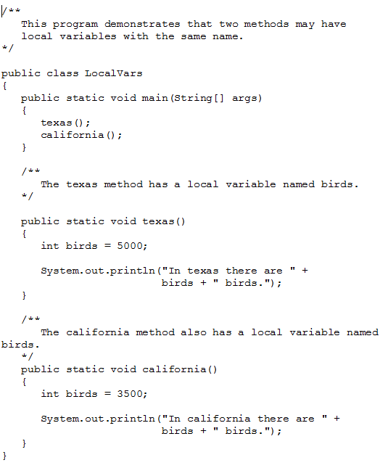

Slide 28
Returning a Value from a Method
Data can be passed into a method by way of the parameter variables. Data may also be returned from a method, back to the statement that called it.
int num = Integer.parseInt("700");
The string “700” is passed into the parseInt method.
The int value 700 is returned from the method and assigned to the num variable.

Slide 29
Defining a Value-Returning Method
Return type
The return statement causes the method to end execution and it returns a value back to the statement that called the method.
This expression must be of the same data type as the return type
public static int sum(int num1, int num2)
{
int result;
result = num1 + num2;
return result;
}

Slide 30
Calling a Value-Returning Method
In main:
{
. . .
total = sum(value1, value2);
. . .
}
public static int sum(int num1, int num2
{
int result;
result = num1 + num2;
return result;
}
20
40
60

Slide 31
@return Tag in Documentation Comments
You can provide a description of the return value in your documentation comments by using the @return tag.
General format
@return Description
See example: ValueReturn.java
The @return tag in a method’s documentation comment must appear after the general description. The description can span several lines.

Slide 32
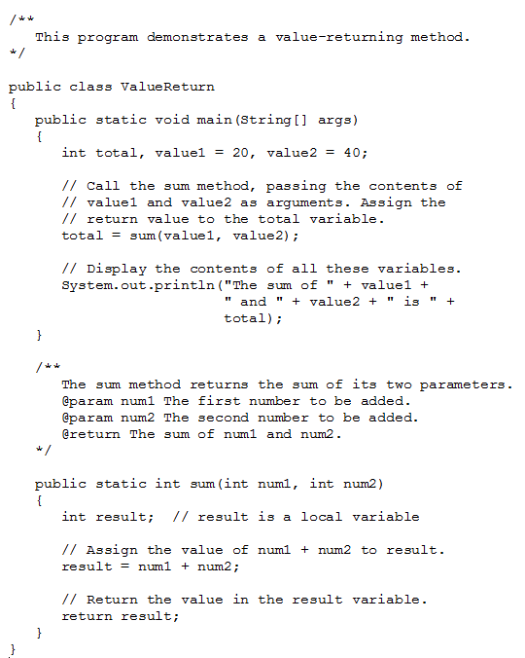

Slide 33
Returning a booleanValue
Sometimes we need to write methods to test arguments for validity and return true or false
public static boolean isValid(int number)
{
boolean status;
if(number >= 1 && number <= 100)
status = true;
else
status = false;
return status;
}
Calling code:
int value = 20;
If(isValid(value))
System.out.println("The value is within range");
else
System.out.println("The value is out of range");

Slide 34
Returning a Reference to a String Object
In main:
{
. . .
customerName = fullName("John", "Martin");
. . .
}
public static String fullName(String first, String last)
{
String name;
name = first + " " + last;
return name;
}
Local variable name holds the reference to the object. The return statement sends a copy of the reference back to the call statement and it is stored in customerName.
address
“John Martin”

Slide 35
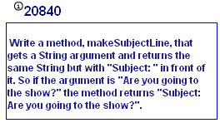
MyProgrammingLab3 5.4

Slide 36
Problem Solving with Methods
A large, complex problem can be solved a piece at a time by methods.
The process of breaking a problem down into smaller pieces is called functional decomposition.
See example: SalesReport.java
If a method calls another method that has a throws clause in its header, then the calling method should have the same throws clause.

Slide 37
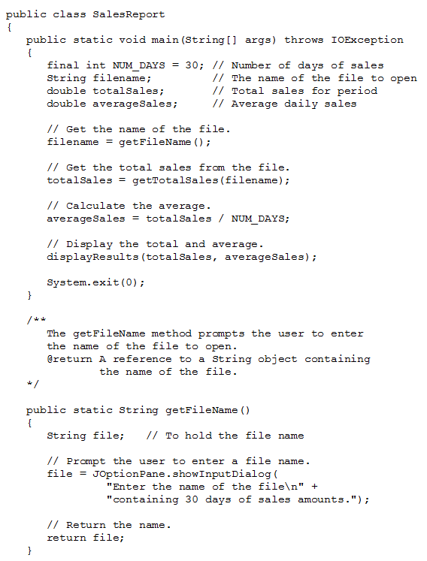

Slide 38
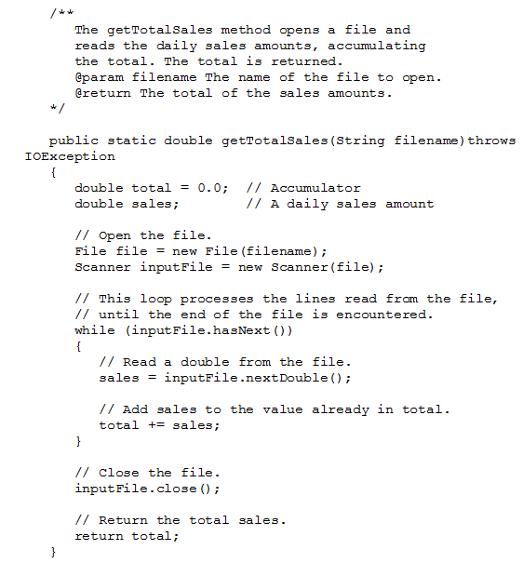

Slide 39
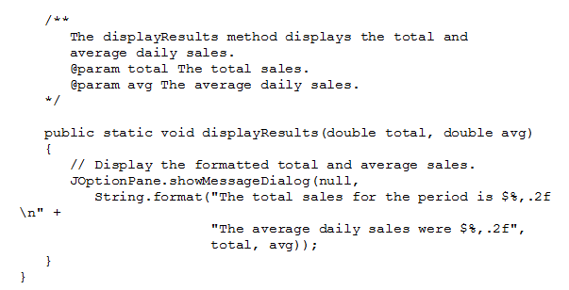

Slide 40
Calling Methods that Throw Exceptions
Note that the main and getTotalSales methods in SalesReport.java have a throws IOException clause.
All methods that use a Scanner object to open a file must throw or handle IOException.
You will learn how to handle exceptions in Module 11.
For now, understand that Java required any method that interacts with an external entity, such as the file system to either throw an exception to be handles elsewhere in your application or to handle the exception locally.

